Slide 1
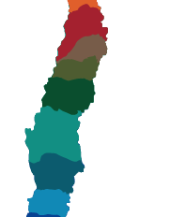
525 DEATHS
23 MISSING
2.000.000
AFFECTED
500.000 HOUSES WITH SEVERE DAMAGES
2nd STRONGEST EARTHQUAKE IN CHILE´S HISTORY
ONE OF 10 STRONGEST IN THE WORLD
CHILE
27/F/2010
3:34:17
8.8
Richter
EARTHQUAKE
TSUNAMI

Slide 2
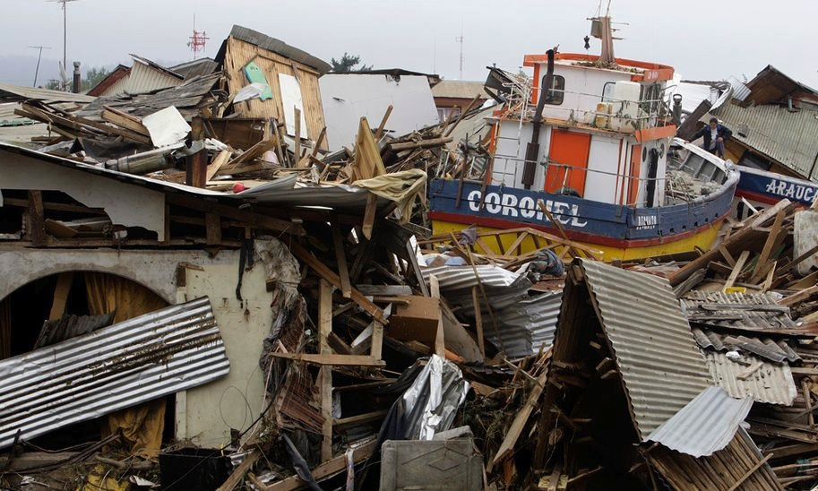

Slide 3
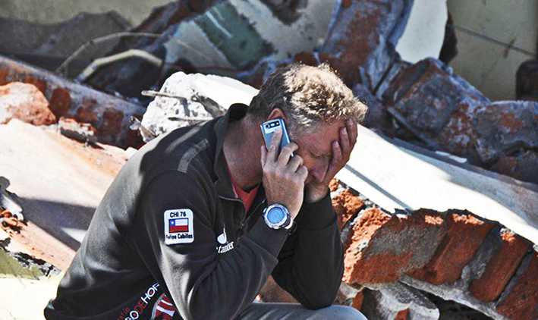
Our
beginning
“This is the greatest catastrophe that this generation will undertake, either we take charge or look at the other side like a fool”
FELIPE CUBILLOS

Slide 4
1
Groundwork with the affected people and their communities to listen from them, their real needs.
We worked as a team with the community
2
We organized the civil society by activating our networks to obtain the resources needed:
Professionals
Private companies
Other NGO’s
3
We served as a bridge between those who can help and those who want to be helped.
We had little time and the needs were many.
We established modular construction models to respond with efficiency.
Notes:
La cita está en ingles

Slide 5
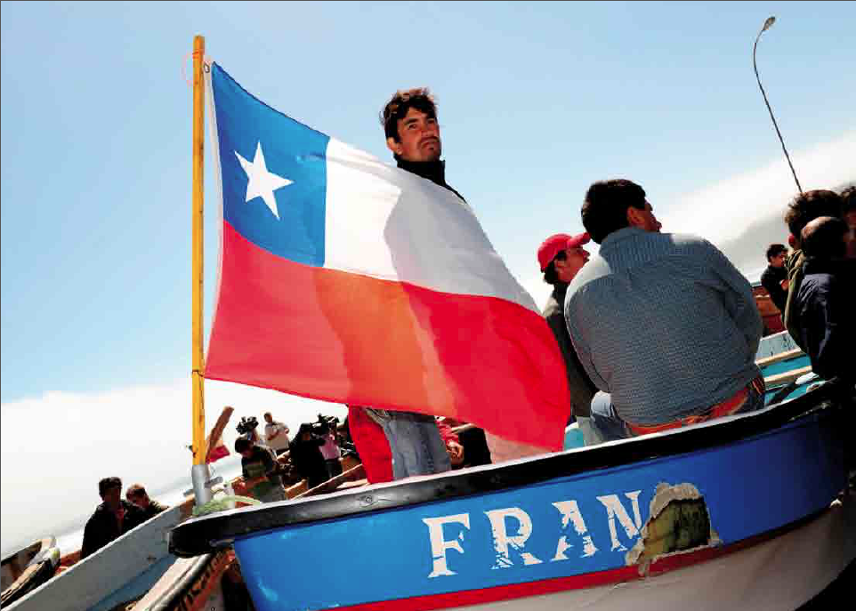
CHALLENGES
1
To aid the fishermen
2
Rebuild
Schools
3
Rebuild small business
4
Rebuild homes

Slide 6
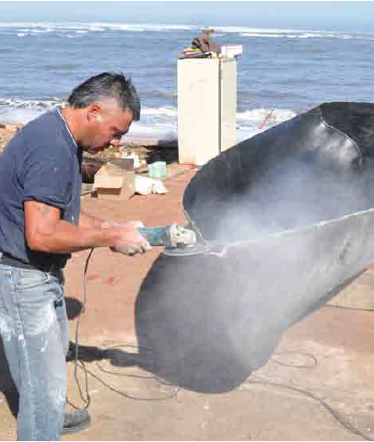
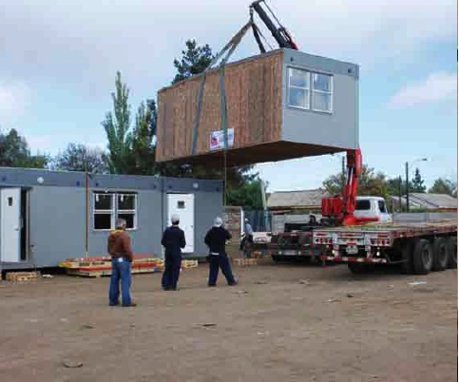
_{03/02/2010}
_{03/21/2010}
_{04/21/2010}
_{05/31/2010}
First fishermen boats
repaired
_{Iloca School}
_{reconstruction}
Juan Fernández
School reconstruction
_{Cauquenes business}
_{reopening}

Slide 7
RESULTS
First 18 months achievements
615
Boats were delivered to the fishermen plus 44 additional external motors
6.226.705
Dollars obtained through the agreement managed by Desafio with the private sector, the government and the fishermen to solve the entire fishing situation.
31
Schools built – 12.500 mts² built
19.000
Children went back to school
55
Small businesses rebuilt
1.200
Mts² commerce built on regions V, VII and VIII
1.000
Children were benefitted through the availability of 9 kindergardens in 3 regions

Slide 8
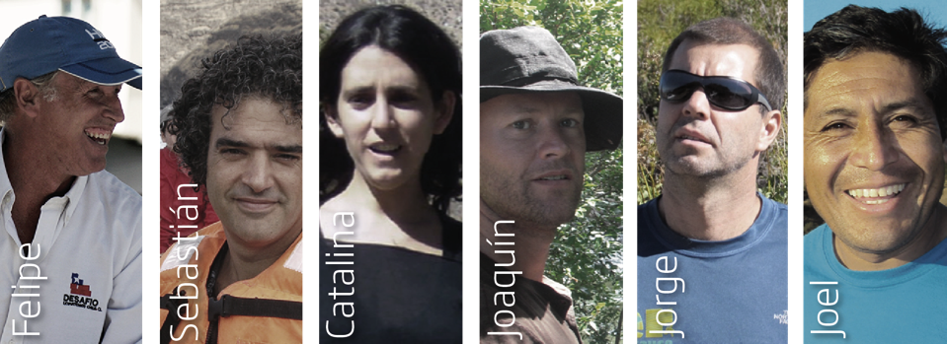
TO CONTINUE
WAS OUR
CHALLENGE
(DESAFÍO)
09/02/2011 Tragedy
Our founder, our executive director, our chief architect, and other 3 members of Desafio, died in a plane accident bound to Juan Fernandez hitting hard the organization’s spirit.

