Slide 1
Transforming chinA’s cities
Meng Fei and Jiang Lin
The Energy Foundation China
the 2nd Pacific Sustainable Cities Conference
March 2014

Slide 2
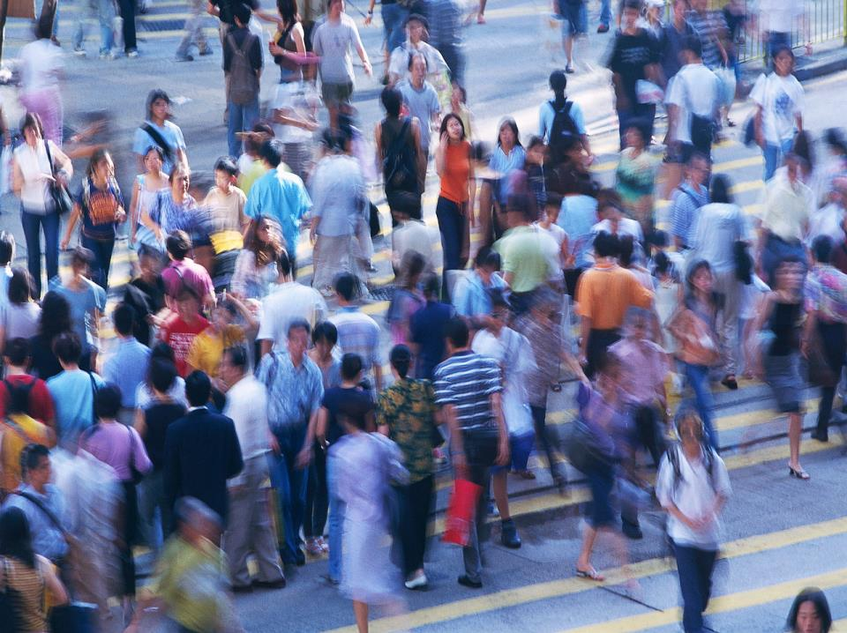
SETTING THE SCENE
China urbanization rate will reach 70%
Urban population will reach 1000 million by 2030
At least 350 million more people will move to cities in the next 20 years
660 cities and 2000 new towns and satellite cities are built and rebuilt in the next 20 years
China urbanization rate will reach
70%
Urban population will reach
1 billion by 2030
At least 350 million more people
will move to the city in the next 20 years
660 cities and 2,000 new towns and
satellite cities will be built and rebuilt in the next 20 years
Notes:
We must influence urban development.
The urbanization China is currently undergoing is the single most significant event globally. In the next two decades, an additional 350 million people, the entire US population, will move to an urban environment, bringing the total urban population in China close to one billion. It is estimated 660 new cities and 2,200 new towns will be built. This urbanization poses extraordinary challenges not to only to China, but also to the world. All CSEP programs converge, in one way or other, to support this unprecedented urbanization. We must influence this urbanization in a way that is environmentally friendly, sustainable and positively impacts quality of life.

Slide 3
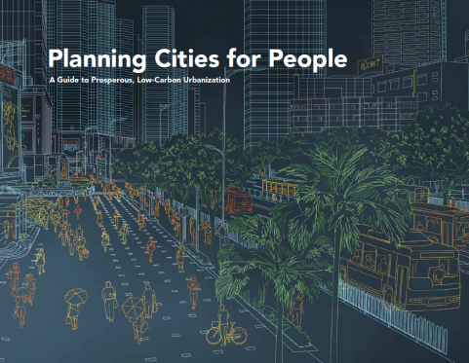
Prosperous, Low-carbon Cities
Develop neighborhoods that promote walking
Prioritize bicycle networks
Create dense networks of streets and paths
Support high-quality transit
Zone for mixed-use neighborhoods
Match density to transit capacity
Create compact regions with short commutes
Increase mobility by regulating parking and road use

Slide 4
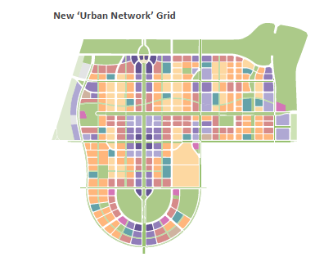
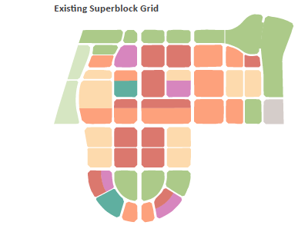
From super-block to dense urban network
Notes:
几个阶段：
Urban design (conceptual level planning) 国际专家参与阶段
Regulatory planning 国内机构
Detailed construction planning 国内、国外都可以，开发商出钱，地块出让后
路网网格
Mixed use

Slide 5
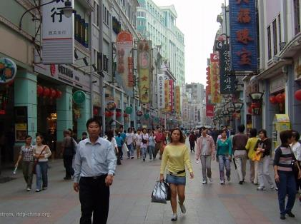
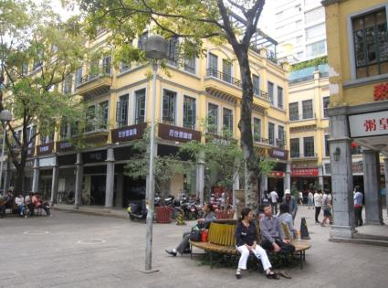
5
Zone for mixed-use neighborhoods
建设多功能混合的邻里社区
A.
Encourage an optimal balance of housing and services through zoning codes.
通过控规指标来实现住宅与服务的最佳平衡
Housing options should accommodate a mix of income levels and age groups.
为不同收入、不同年龄的人提供住房选择
Shops, schools, parks, and services should be located within 400 meters of housing. This includes age-specific services, such as day care.
住宅距离商店、学校、公园和服务机构不应超过400米，包括针特定年龄人群，例如托儿所。
Mix housing, shops and services within commercial districts to create 24 hr communities.
Notes:
Every trip starts with a pedestrian
Good walking environments makes transit much more attractive
Good walking environments require: sidewalks, street crossings, varied facades, lighting, mixed-use, safety, convenience (local destinations and reduced trip demands)
A street that inspires walking is the hallmark of a good city.
Voting with feet

Slide 6
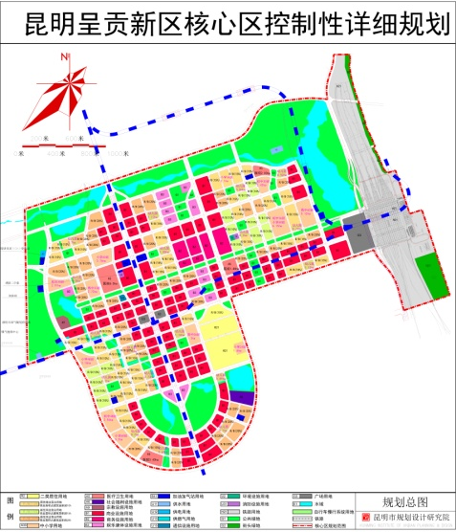
Regulatory Detailed Plan
Courtesy of Kunming Urban Planning Institute
Notes:
最后地方团队出的控规图纸，图则

Slide 7
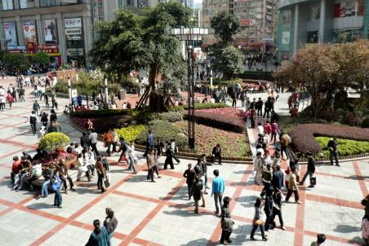
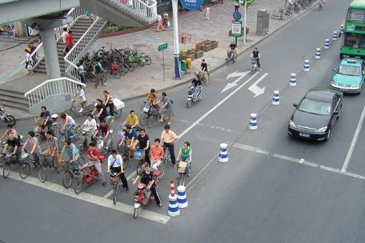
1
Develop neighborhoods that promote walking
2
Chongqing, China
Prioritize bicycle networks
Bike-prioritized Intersection
Bike-prioritized Intersection
Notes:
National demos of Non-motorized transport (NMT) in 6 cities, including bicycling and walking
Every trip starts with a pedestrian
Good walking environments makes transit much more attractive
Good walking environments require: sidewalks, street crossings, varied facades, lighting, mixed-use, safety, convenience (local destinations and reduced trip demands)
A street that inspires walking is the hallmark of a good city.
Voting with feet

Slide 8
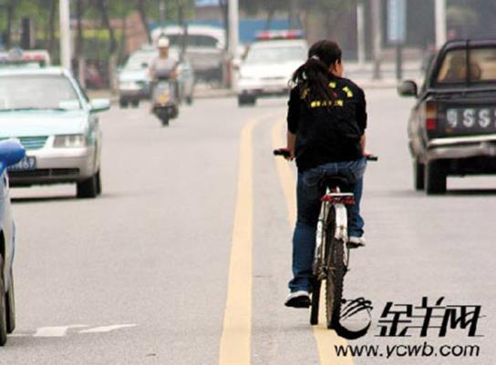
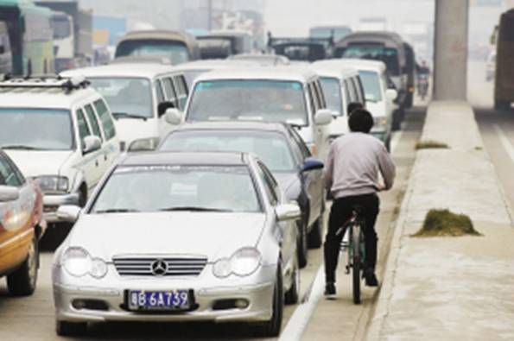
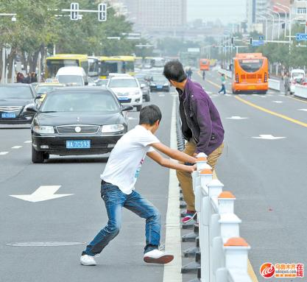
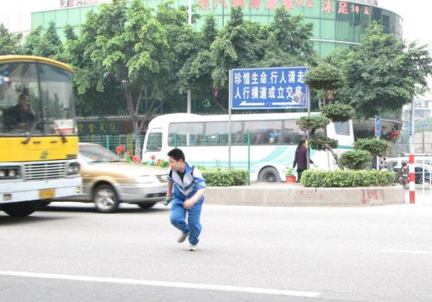

Slide 9
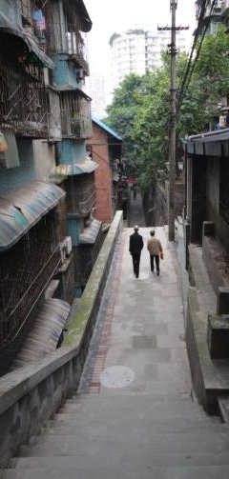
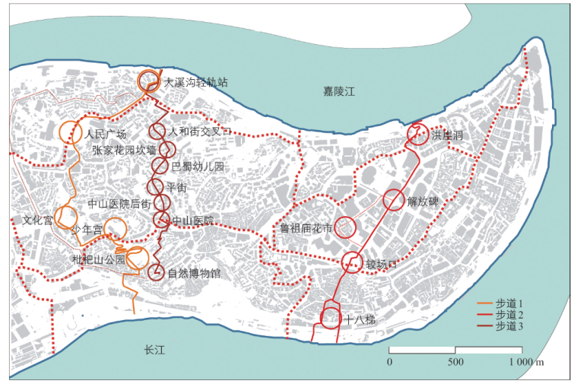
Chongqing: a Mountain City

Slide 10
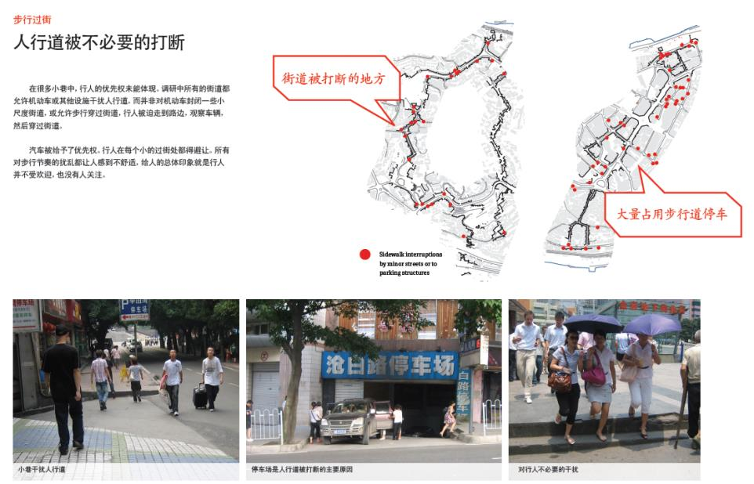
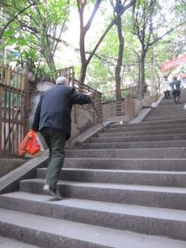
Sidewalk/Accessibility

Slide 11
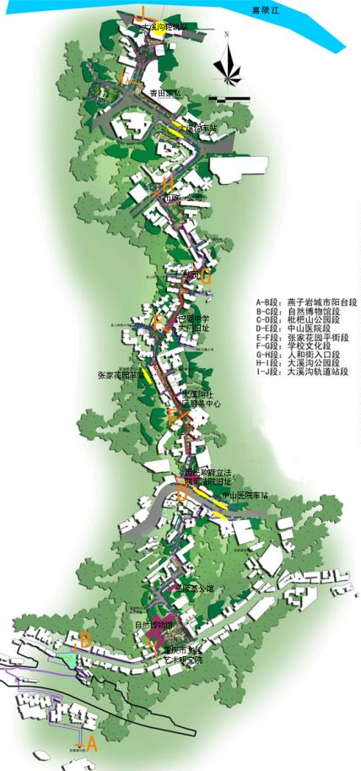
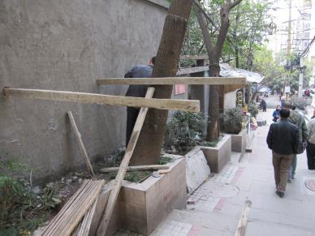
Pilot Implementation
3.9km route
8 segments
7 public space nodes
Courtesy of Chongqing Urban Planning Institute

Slide 12
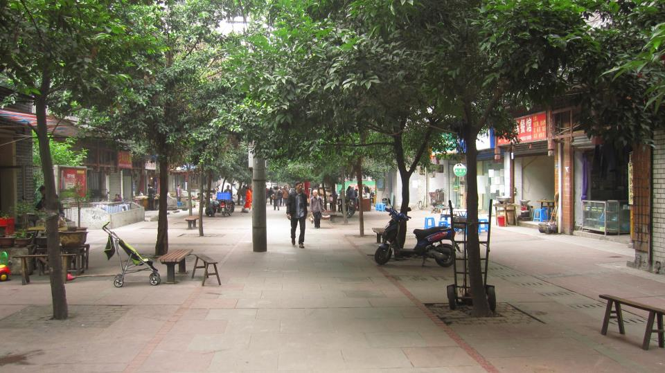
Notes:
界面杂乱，没有座椅、路灯

Slide 13
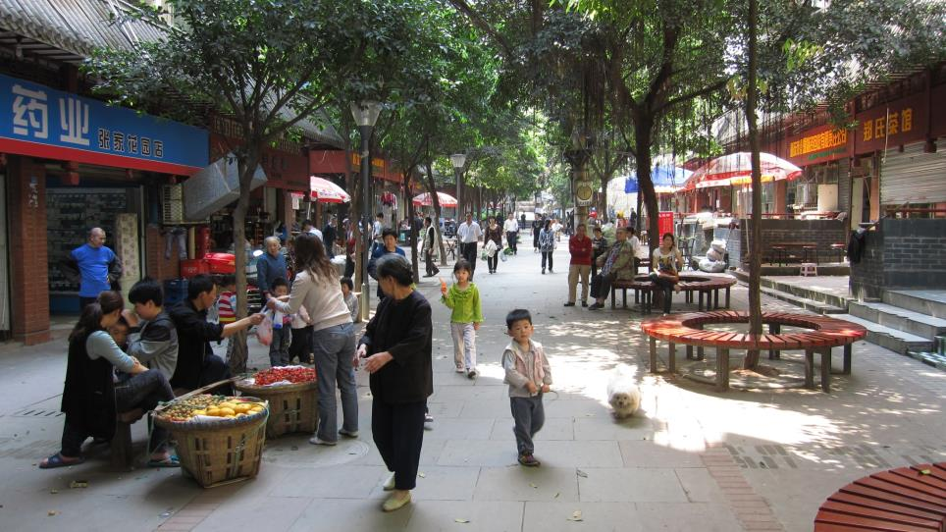

Slide 14
Notes:
地标性指示，照明

Slide 15
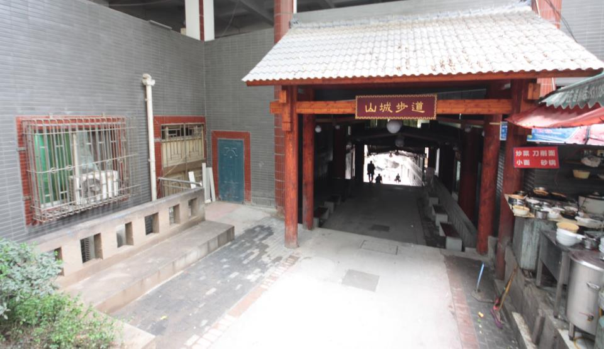
Notes:
Map stone

Slide 16
Notes:
幼儿园，休息，等待，界面消极（negative/inactive facade)

Slide 17
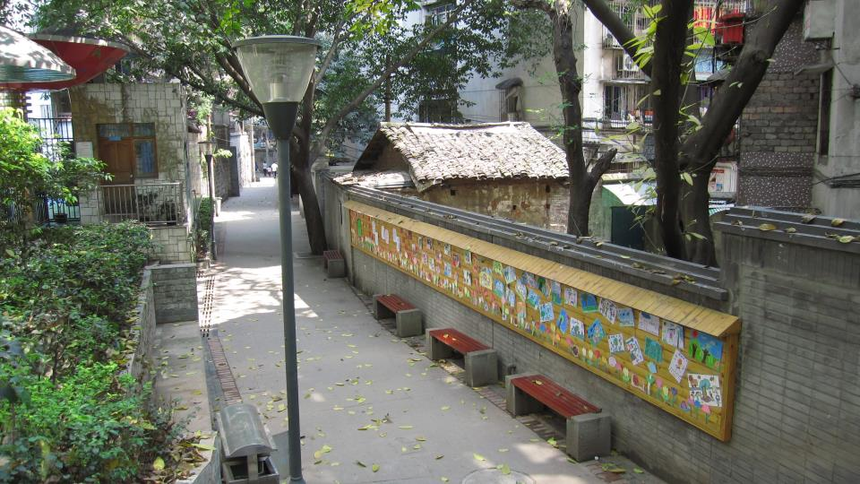

Slide 18
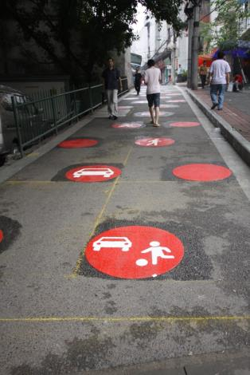
Notes:
Way finding
Traffic calming measures
Logo/way finding

Slide 19
LOGIC MODEL
Pilots
initiate concepts
On site technical assistance and training
Technical guidelines
& principles
Scale up to 10% of the cities
Pilots
verify concepts
Develop training courses and build core team
Voluntary policies
& incentives
Scale up to 50%
Pilots demonstrate
techniques & capacity
Develop training materials and train the trainee
Mandatory policies
& standards/codes
Scale up to 90%
Fully Scale Up
Notes:
- To be improved: simplify and make more generic to all program areas. The main point is pilots to policy.

Slide 20
FROM PILOTS TO POLICY: NMT
National NMT promotion (MOHURD):
National Pilots : 6 cities 12 cities 100 cities
Construction of demonstration sites
Local NMT planning guideline
City wide NMT special planning
Local Incentive policies to promote NMT development
National instruction on the promotion of NMT
National NMT planning guideline and incentive policies

Slide 21
Prosperous, Low-carbon Cities
Develop neighborhoods that promote walking
Prioritize bicycle networks
Create dense networks of streets and paths
Support high-quality transit
Zone for mixed-use neighborhoods
Match density to transit capacity
Create compact regions with short commutes
Increase mobility by regulating parking and road use

Slide 22
Thank you! 谢谢！

Slide 23
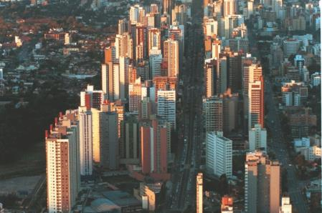
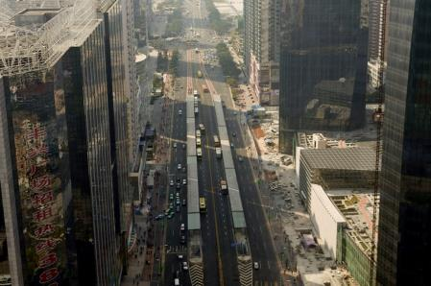
6
Match density to transit capacity
In Curitiba, Brazil, high-rise development is focused within 200 meters of mass transit lines.
In Guangzhou, density is focused around the BRT corridor. The system’s capacity matches commute-hour transit demand.
Notes:
Systems support peak-hour demand
Concentrate density around corridor

Slide 24
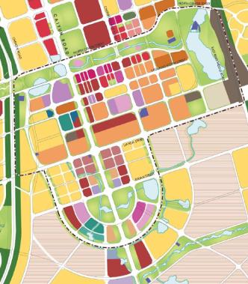
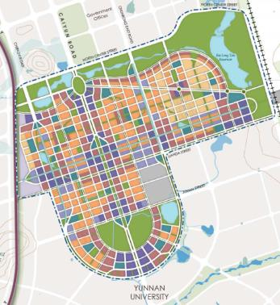
RESULTS – FROM SUPERBLOCKS TO HUMAN SCALE STREETS
SUPERBLOCKS IN EXISTING PLAN
REDUCED BLOCK SIZE IN NEW PLAN
Notes:
道路网和街区尺度
原方案:
9-25公顷巨型街区
道路尺度大
以汽车为中心的规划
新方案:
1-1.5公顷小地块
小尺度、细密网格街区
以人为本的规划
用地
原方案:
用地功能单一
开发强度与公共交通不协调
新方案:
地块间平面、地块内竖向混合
围绕公共交通节点高强度开发
公共交通网络
原方案:
公共交通供给不强
BRT和地铁一体化弱
新方案：
每隔600-800m一条BRT
一体化的网络
BRT和慢行专用路
新方案：慢行专用道路网络
所有街道都规划步道和自行车道
与重要活动中心联系的慢行专用街道

Slide 25
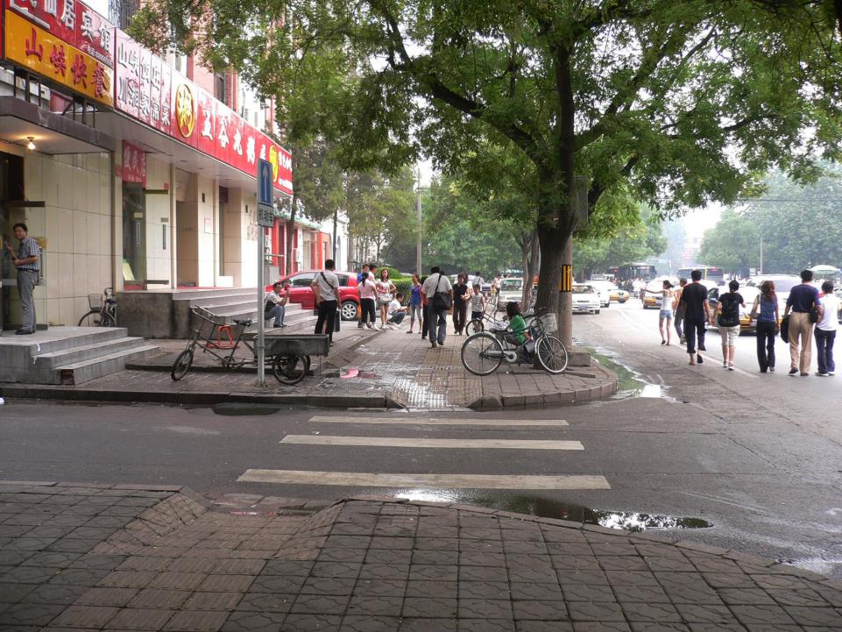

Slide 26
