Slide 1
Mobility Initiatives in Metro Manila Department of Transportation and Communications
12 March 2014

Slide 2
Line 1 Cavite Extension
Construction of 11.7 km of rail to connect Baclaran terminal station to Niyog in Bacoor, Cavite
Project Cost: Php 64.9 B
Includes construction of 3 intermodal facilities and 1 satellite depot
Will serve an additional 500,000 to 700,000 riders daily
Project rebid ongoing

Slide 3
Line 2 East Extension
Construction of 4.19 km of rail from Santolan terminal station to Masinag, Antipolo
Project Cost: Php 9.76 B
Will serve an additional 120,000 riders daily
Consultancy for Detailed Engineering Design (DED) awarded;
Consultancy for Electro-Mechinical Systems undergoing bid evaluation

Slide 4
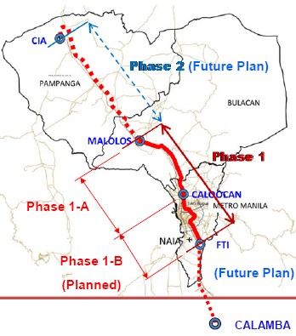
North-South Commuter Rail
Description
Design and construction of a standard gauge commuter rail line for approx. 90 km from Malolos, Bulacan to Calamba, Laguna
Involves procurement of rolling stock and installation of electro-mechanical systems
Also passes through Cavite, Batangas, Metro Manila, Rizal, and Quezon
Cost: USD 6.307 B
After Project
Expected annual demand of 750,000 in 2020; and over 1 M in 2030
Status
For NEDA Board approval
Alignment

Slide 5
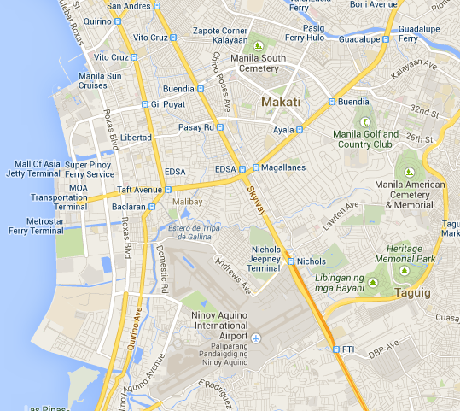
Mass Transit System
Description
Aims to connect the cities of Makati, Pasay and Taguig via a rail-based mass transit system
Estimated Cost: USD 3.2 B
Status
Feasibility Study ongoing,
for completion by June 2014
Manila
Makati
Pasay
Bonifacio Global City
Parañaque

Slide 6
Common Station, BRT
Project | Description
Common Station | Establishment of an elevated station to connect the following lines: LRT 1, MRT 3, and MRT 7 For bidding
Manila (Quezon Ave) BRT | Development of bus-based corridor improvement initiatives between Fairview and Manila City Hall Involves establishment of 31 stations along Quezon Avenue Involves improvement of ancillary structures for pedestrians For submission to NEDA

Slide 7
Initiatives for NCR
Line 1 Metro Line 2 Metro Line 3 Metro PNR Commuter PNR Inter-City
Line 7
ITS
Bus Systems
C5 Corridor Improvement
Manila (Quezon Ave) BRT
Ferry
MRT7
bus

Slide 8
Thank you.

